Slide 1
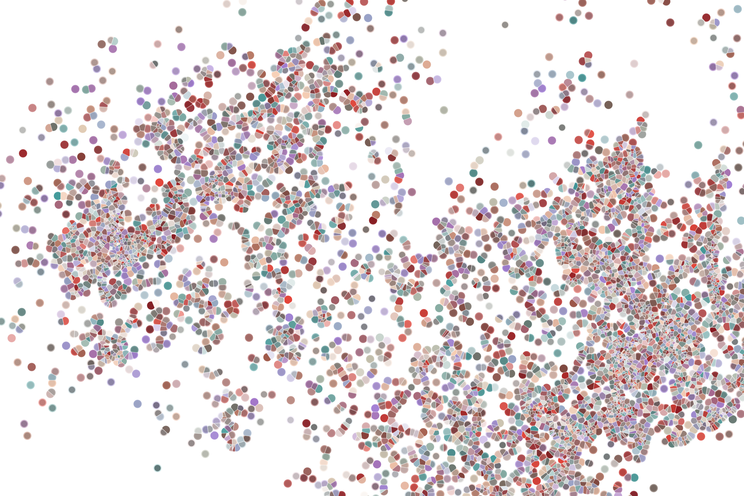
Bioconductor submission
Physalia course 2022
Instructor: Jacques Serizay
Notes:
Hello everybody and thank you for attending my presentation. I am going to talk about the project I recently started working on in the Spassky and Koszul labs, both located in Paris. This project focuses on the unusual cooption of the mitotic machinery to drive, not cell division but cell differentiation.

Slide 2
Standard package submission process
This is the main page (I recommend) to get information regarding submission process:
https://contributions.bioconductor.org/bioconductor-package-submissions.html
TL;DR:
https://github.com/Bioconductor/Contributions

Slide 3
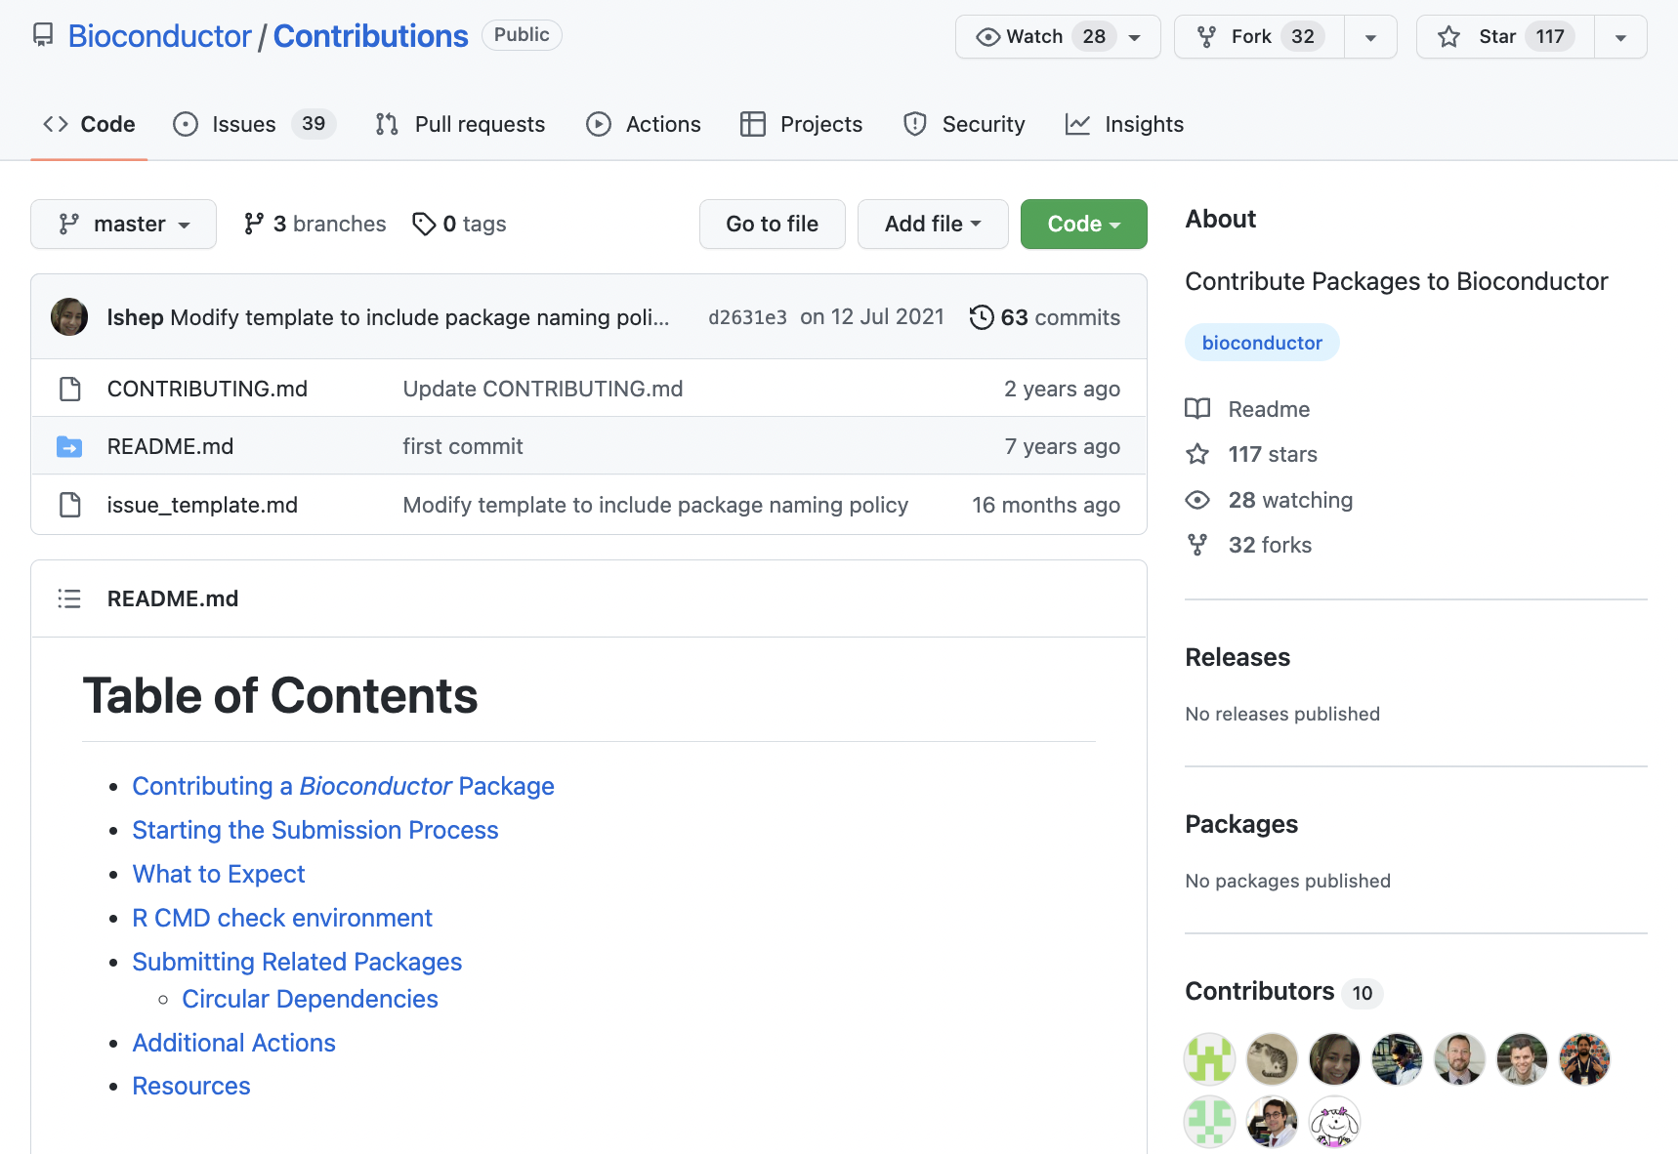
Standard package submission process

Slide 4
Standard package submission process
0. Make sure your package works fine
> devtools::check()

Slide 5
Standard package submission process
0. Make sure your package works fine
0b. Make sure your package works fine
> devtools::check()
> BiocCheck:: BiocCheck()

Slide 6
Standard package submission process
0. Make sure your package works fine
0b. Make sure your package works fine
0c. Make sure your package works fine
> devtools::check()
> BiocCheck:: BiocCheck()
> rcmdcheck::rcmdcheck()

Slide 7
Standard package submission process
0. Make sure your package works fine
0b. Make sure your package works fine
0c. Make sure your package works fine
0d. Make sure your package works fine
> devtools::check()
> BiocCheck:: BiocCheck()
> rcmdcheck::rcmdcheck()
Github Actions

Slide 8
Standard package submission process
0. Make sure your package works fine
0b. Make sure your package works fine
0c. Make sure your package works fine
0d. Make sure your package works fine
0e. Few other check-ups:
Version number? HAS TO BE 0.99.0
Your SSH key?
> devtools::check()
> BiocCheck:: BiocCheck()
> rcmdcheck::rcmdcheck()
Github Actions

Slide 9
Standard package submission process
0. Make sure your package works fine
0b. Make sure your package works fine
0c. Make sure your package works fine
0d. Make sure your package works fine
0e. Few other check-ups:
Version number?
Your SSH key?
And then…
> devtools::check()
> BiocCheck:: BiocCheck()
> rcmdcheck::rcmdcheck()
Github Actions

Slide 10
Submitting initial issue to Bioconductor
Submit an issue to Bioconductor/Contributions

Slide 11
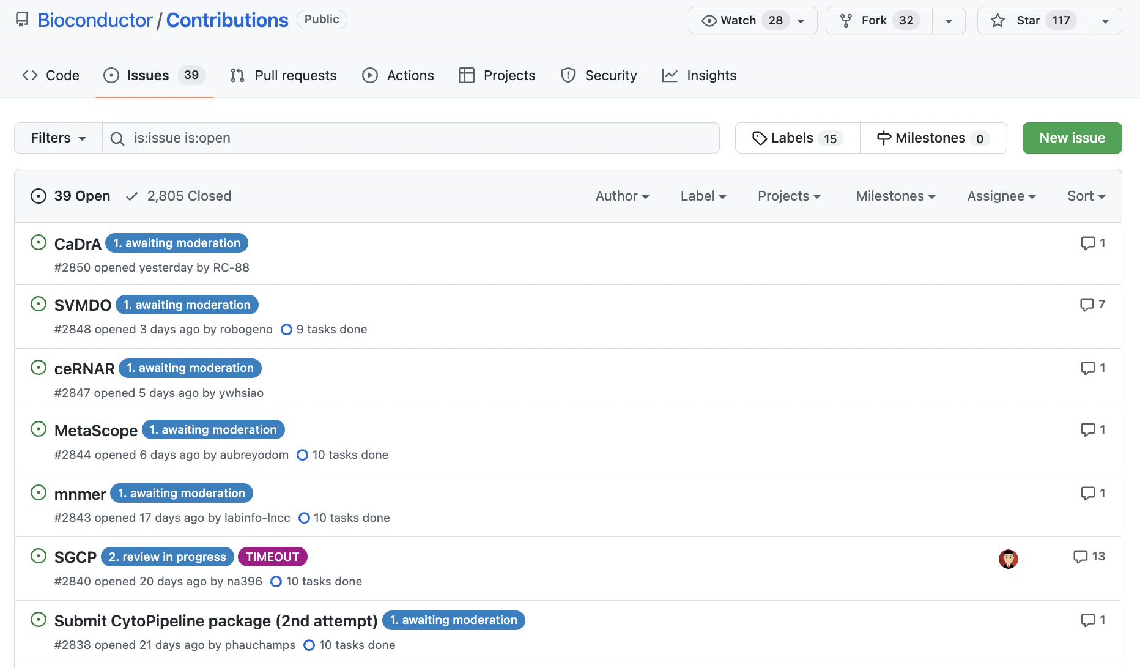
Submitting initial issue to Bioconductor
Submit an issue to Bioconductor/Contributions

Slide 12
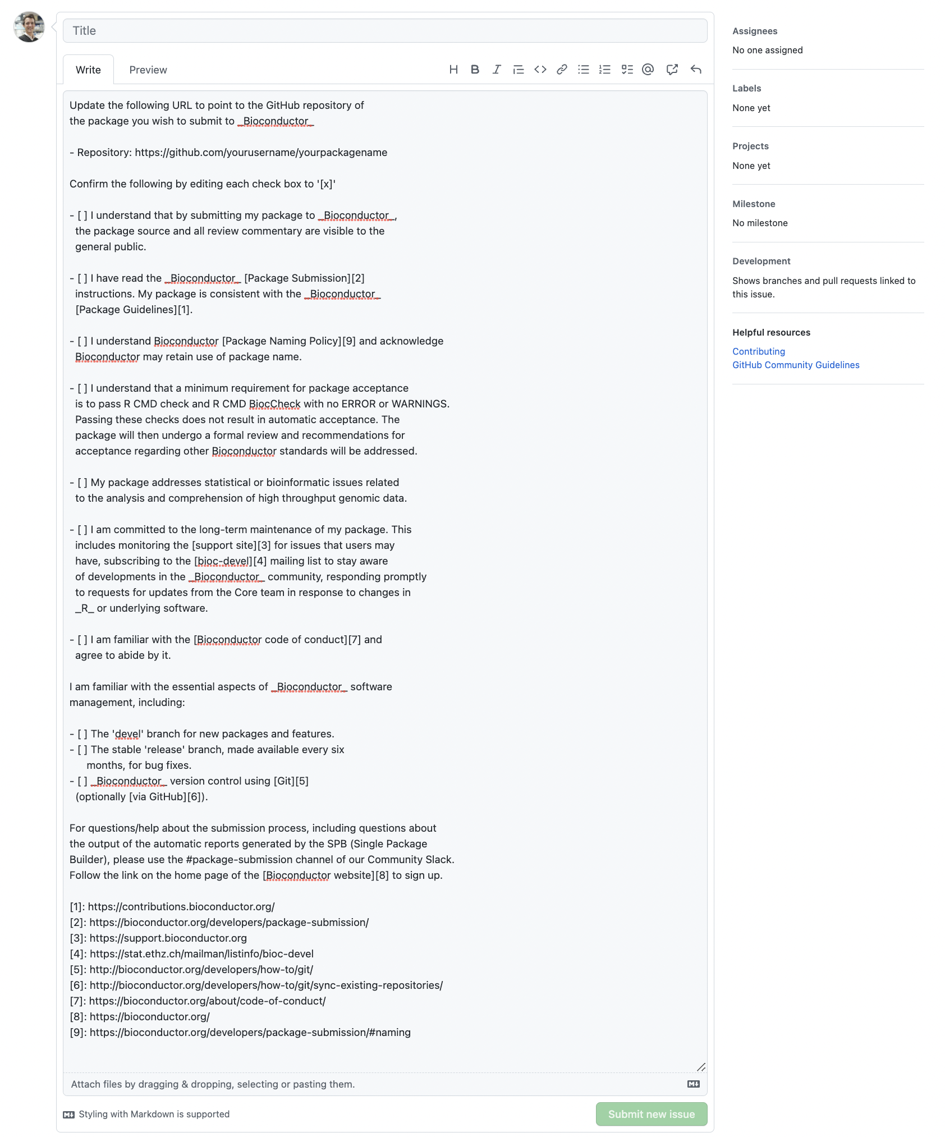
Submitting initial issue to Bioconductor

Slide 13
Submitting initial issue to Bioconductor

Slide 14
Submitting initial issue to Bioconductor

Slide 15
Submitting initial issue to Bioconductor

Slide 16
Submitting initial issue to Bioconductor

Slide 17
Submitting initial issue to Bioconductor

Slide 18
Submitting initial issue to Bioconductor

Slide 19
Submitting initial issue to Bioconductor

Slide 20
Submitting initial issue to Bioconductor

Slide 21
Submitting initial issue to Bioconductor

Slide 22
Await for a Bioconductor team member to be selected to review your package
2. Patiently await for moderators to pre-check your package

Slide 23
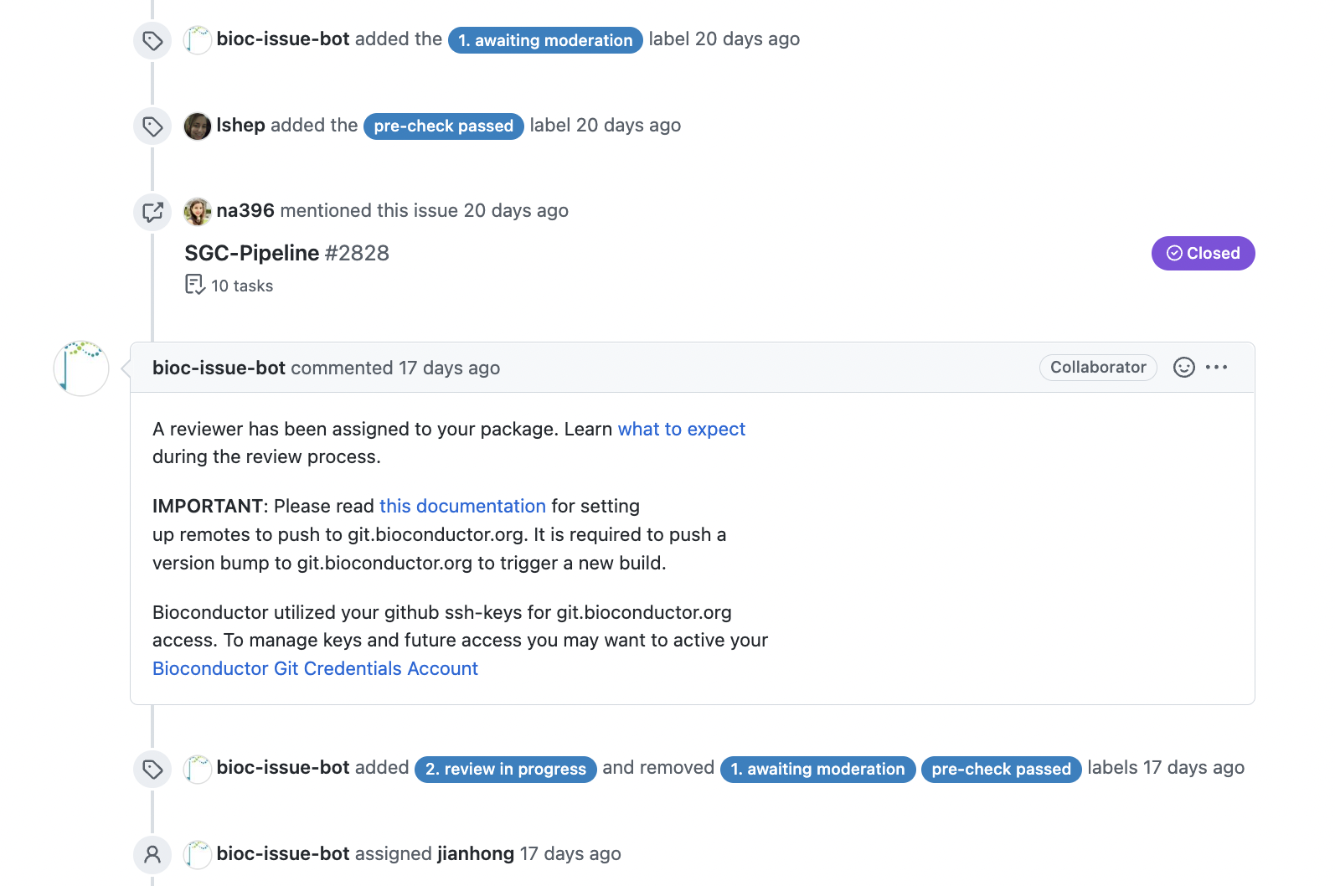
Await for a Bioconductor team member to be selected to review your package

Slide 24
Moving to (pre-)review process
The “2. review in progress” tag is slightly mis-leading.
Your reviewer is not likely to have a look at your package as soon as they are assigned to review it.

Slide 25
Moving to (pre-)review process
The “2. review in progress” tag is slightly mis-leading.
Your reviewer is not likely to have a look at your package as soon as they are assigned to review it.
And this is because of…

Slide 26
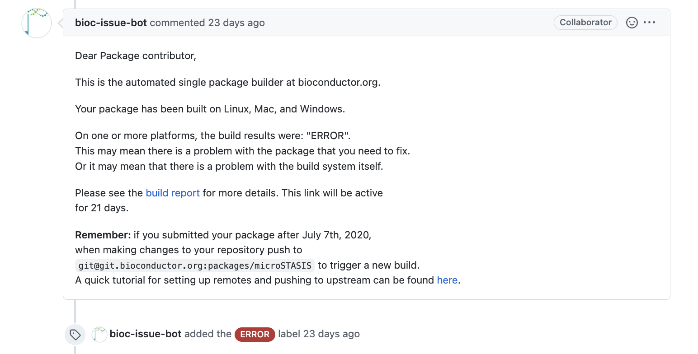
Moving to (pre-)review process
The “2. review in progress” tag is slightly mis-leading.
Your reviewer is not likely to have a look at your package as soon as they are assigned to review it.
And this is because of…

Slide 27
The most dreaded Bioconductor Build System (BBS)
Once your package is in review, a new ”sub-repo” is created in Bioconductor’s GitHub (in the `packages` repo), synchronized with your own GitHub.
> git clone git@git.bioconductor.org:packages/microSTASIS.git
Cloning into 'microSTASIS'...
remote: Enumerating objects: 283, done.
remote: Counting objects: 100% (283/283), done.
remote: Compressing objects: 100% (164/164), done.
remote: Total 283 (delta 183), reused 154 (delta 103), pack-reused 0
Receiving objects: 100% (283/283), 1012.15 KiB | 2.80 MiB/s, done.
Resolving deltas: 100% (183/183), done.

Slide 28
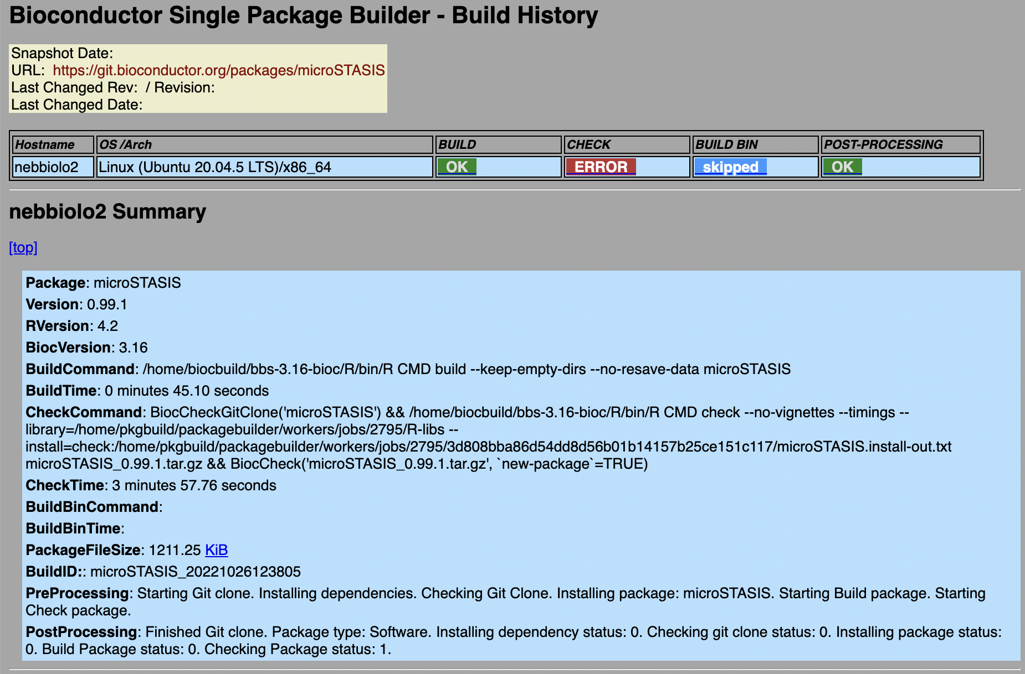
The most dreaded Bioconductor Build System (BBS)
Then Bioconductor heavy machines (the Single Package Builder) run-run-run.

Slide 29
The most dreaded Bioconductor Build System (BBS)
Then Bioconductor heavy machines (the Single Package Builder) run-run-run.

Slide 30
The most dreaded Bioconductor Build System (BBS)
Then Bioconductor heavy machines (the Single Package Builder) run-run-run.

Slide 31
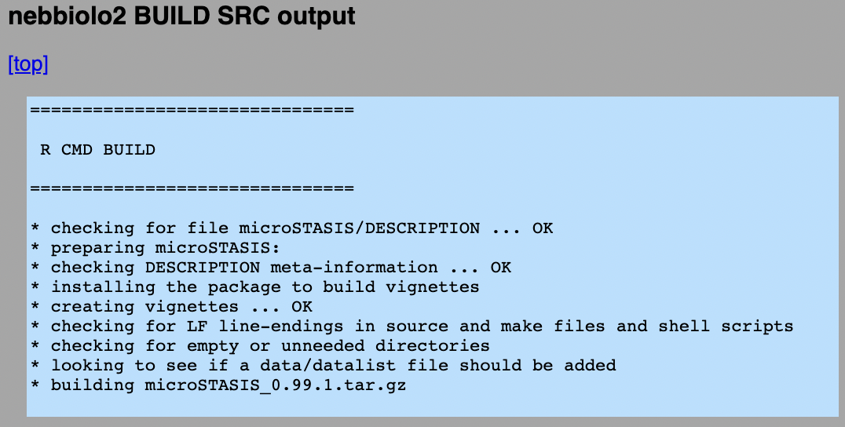
The most dreaded Bioconductor Build System (BBS)

Slide 32
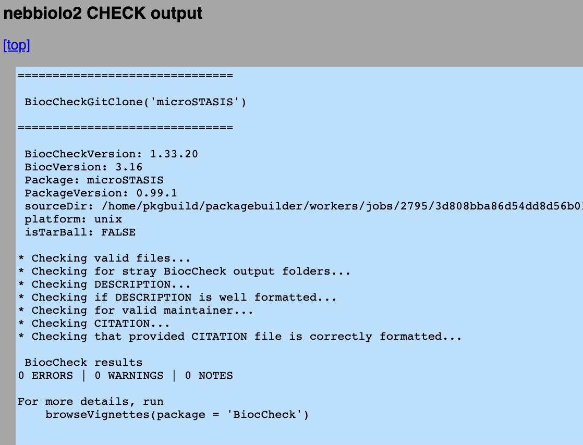
The most dreaded Bioconductor Build System (BBS)

Slide 33
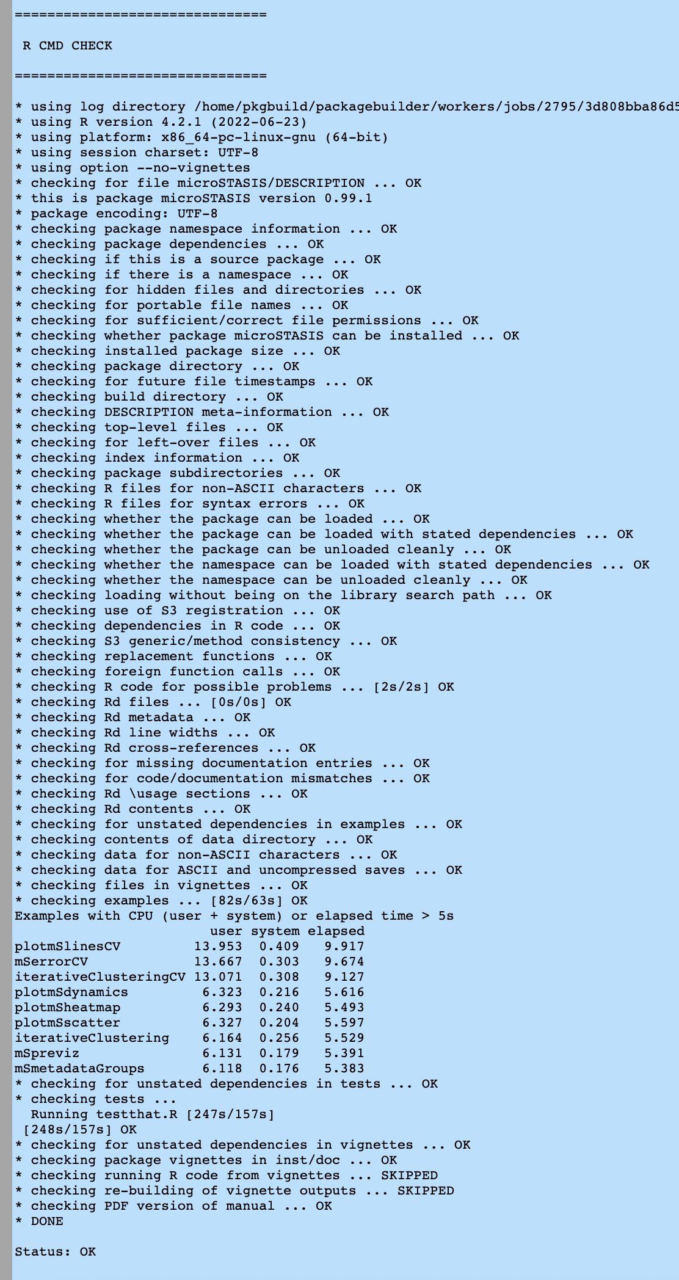
The most dreaded Bioconductor Build System (BBS)

Slide 34
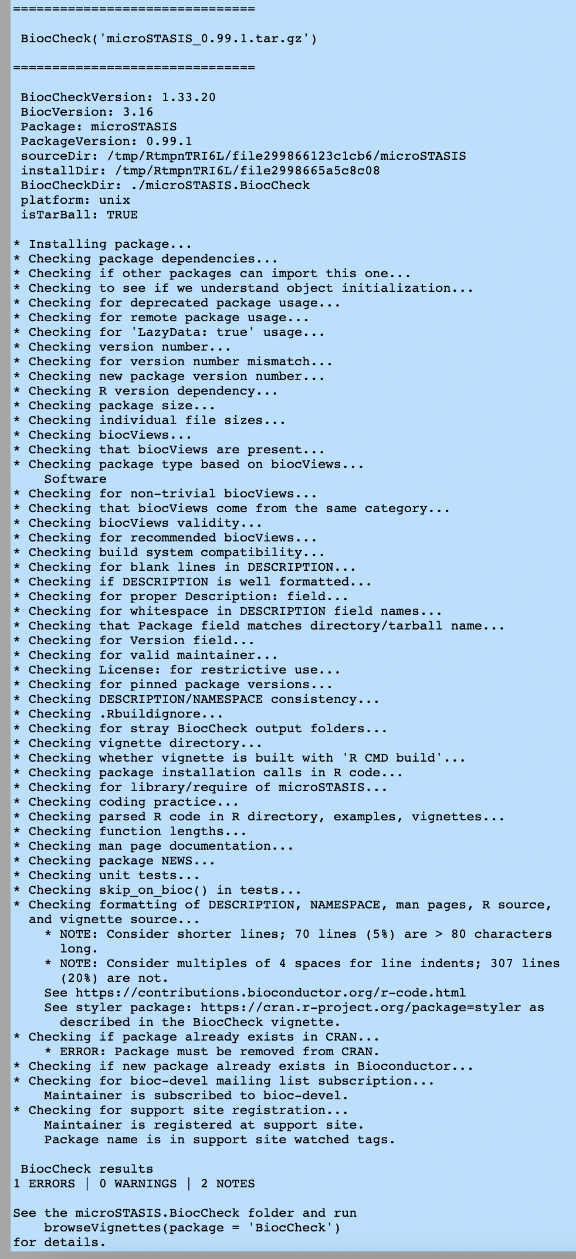
The most dreaded Bioconductor Build System (BBS)

Slide 35
The most dreaded Bioconductor Build System (BBS)

Slide 36
The most dreaded Bioconductor Build System (BBS)

Slide 37
Moving to (pre-)review process
3. Fix errors!
4. Fix errors!
5. Fix errors!

Slide 38
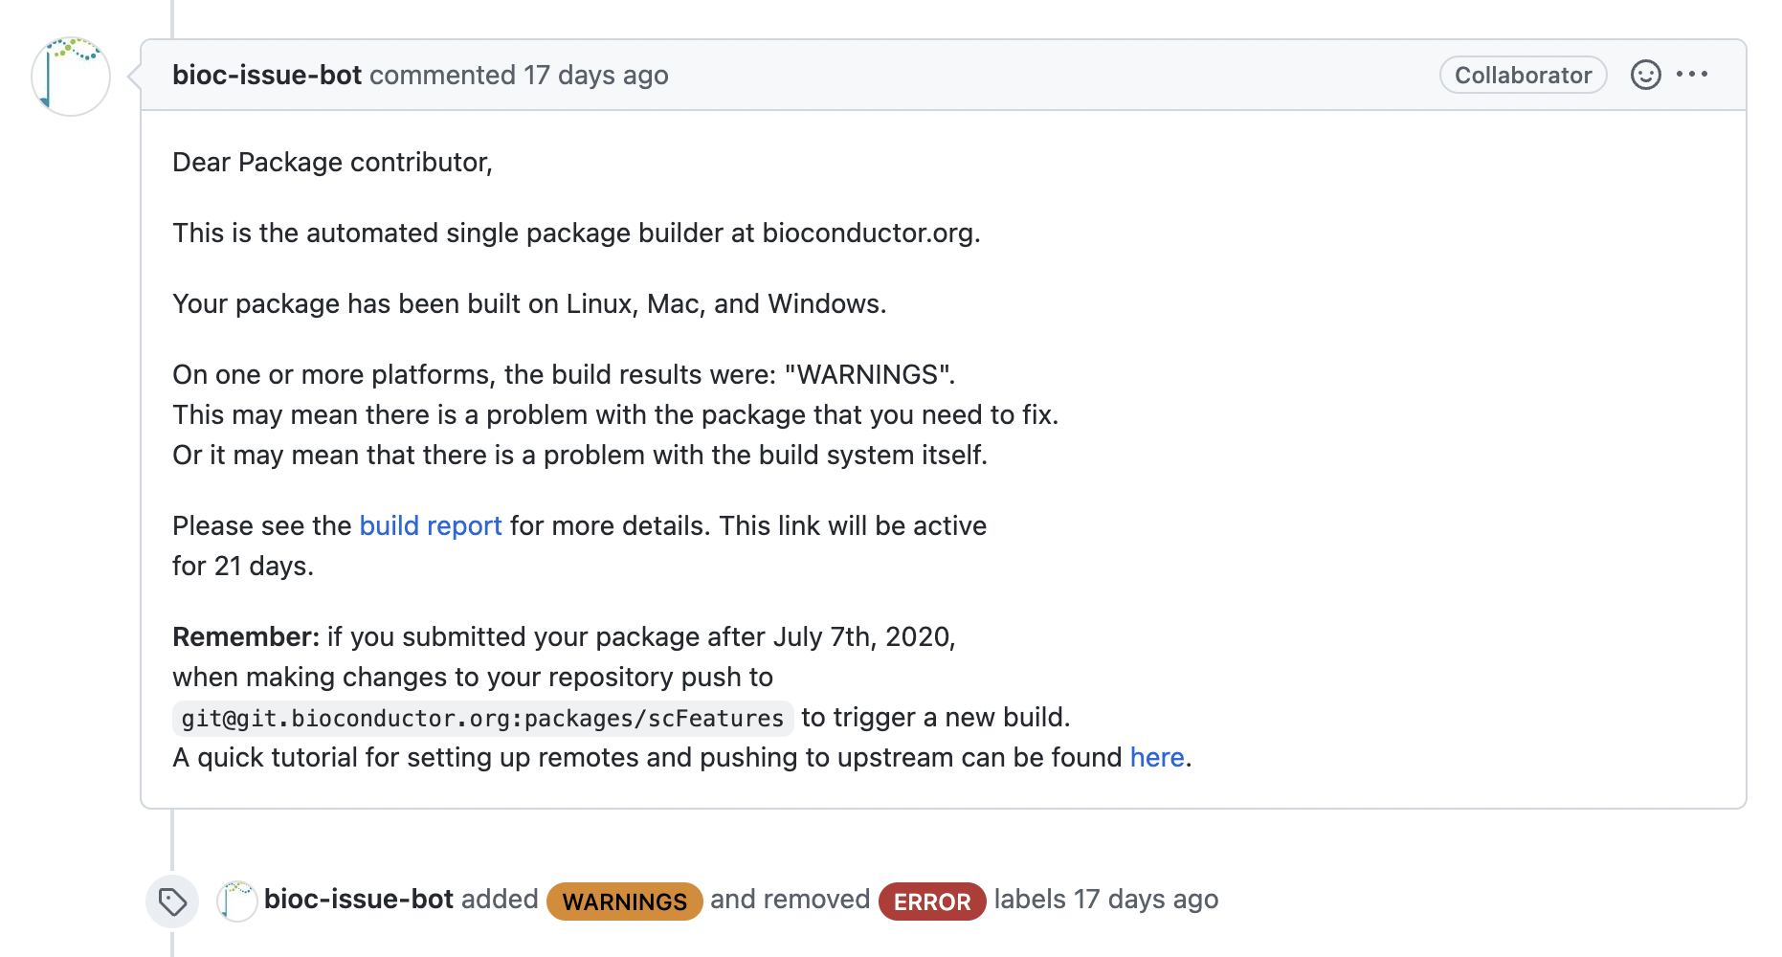
Fixing errors/warnings
Check the build reports.

Slide 39
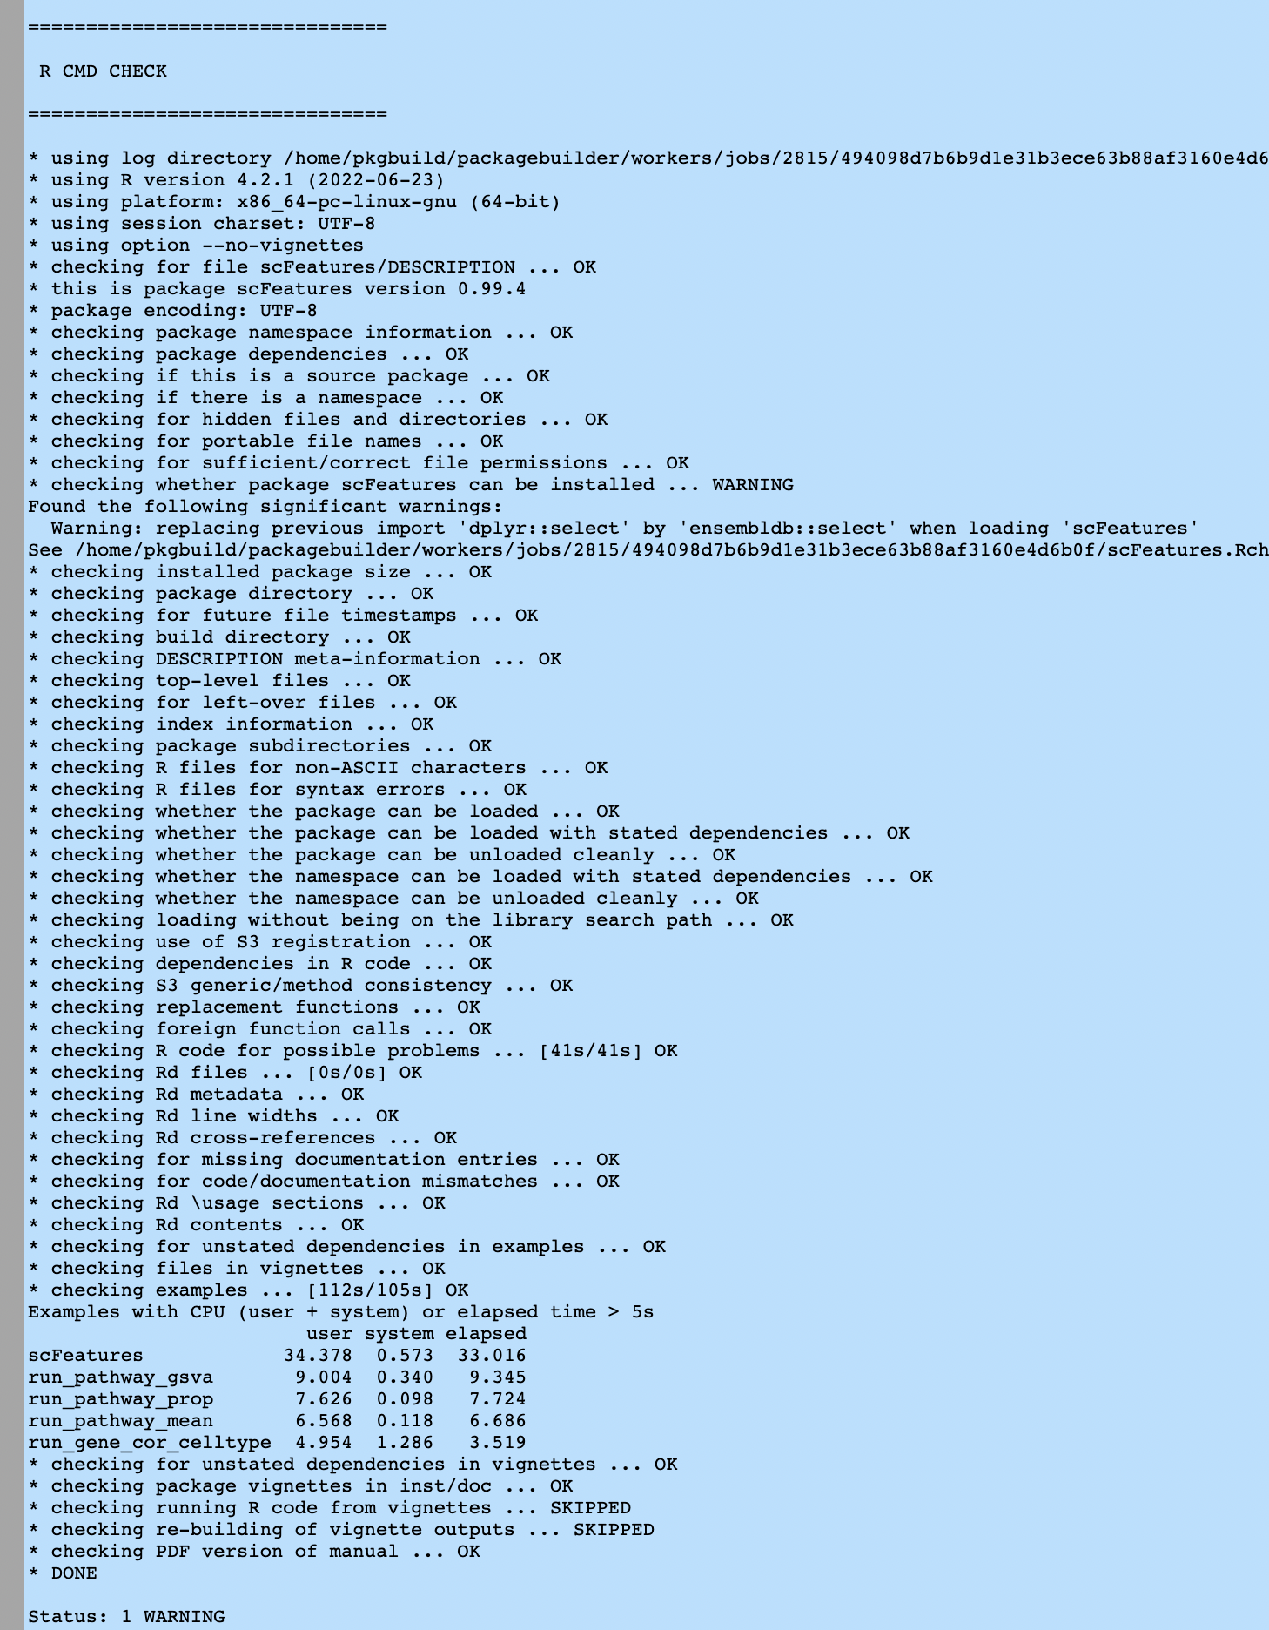
Fixing errors/warnings
Check the build reports.
Identify where the problem(s) occurred.

Slide 40
Fixing errors/warnings
Check the build reports.
Identify where the problem(s) occurred.
Optional: ask Bioconductor people!!

Slide 41
Fixing errors/warnings
Check the build reports.
Identify where the problem(s) occurred.
Optional: ask Bioconductor people!!
Please don’t: ask directly in the issue…
Please do: ask on bioc-devel mailing list!

Slide 42
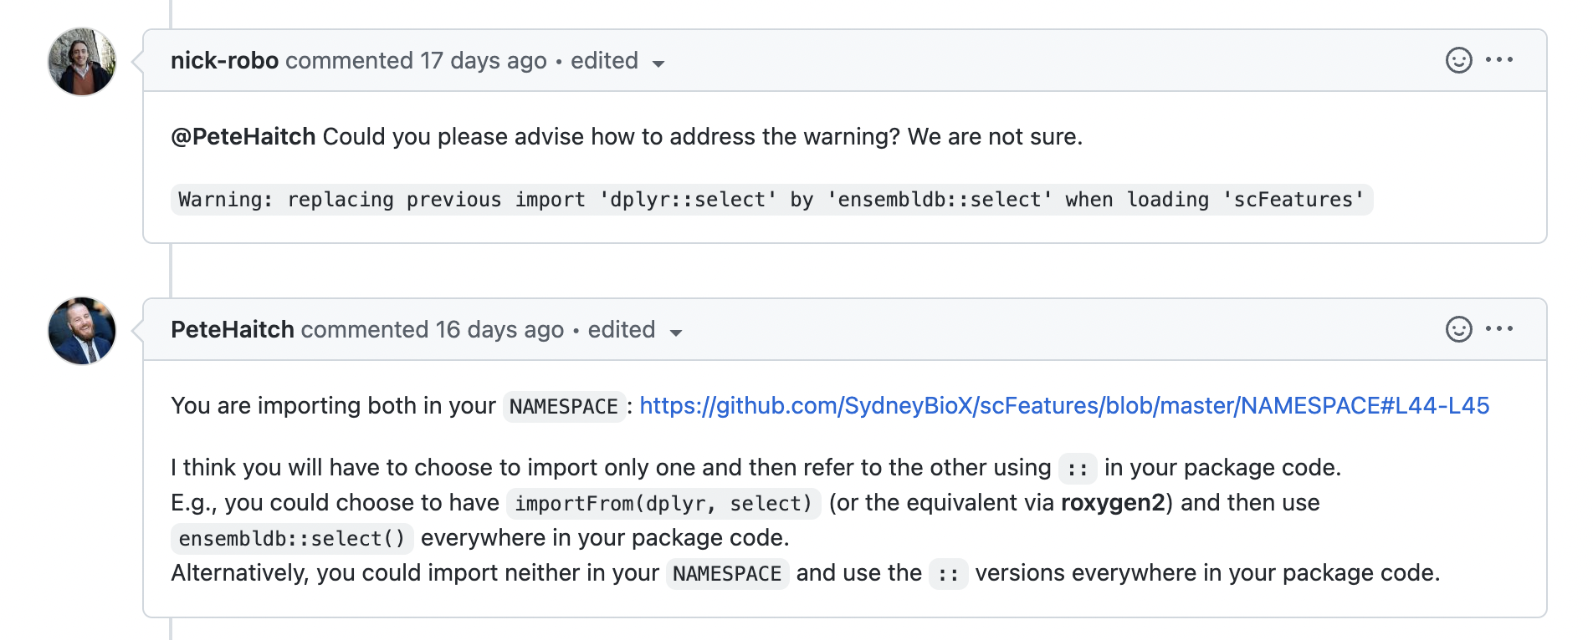
Fixing errors/warnings
Check the build reports.
Identify where the problem(s) occurred.
Optional: ask Bioconductor people!!

Slide 43
Fixing errors/warnings
Check the build reports.
Identify where the problem(s) occurred.
Optional: ask Bioconductor people!!
Attempt to fix your errors
Change your code locally
Check locally

Slide 44
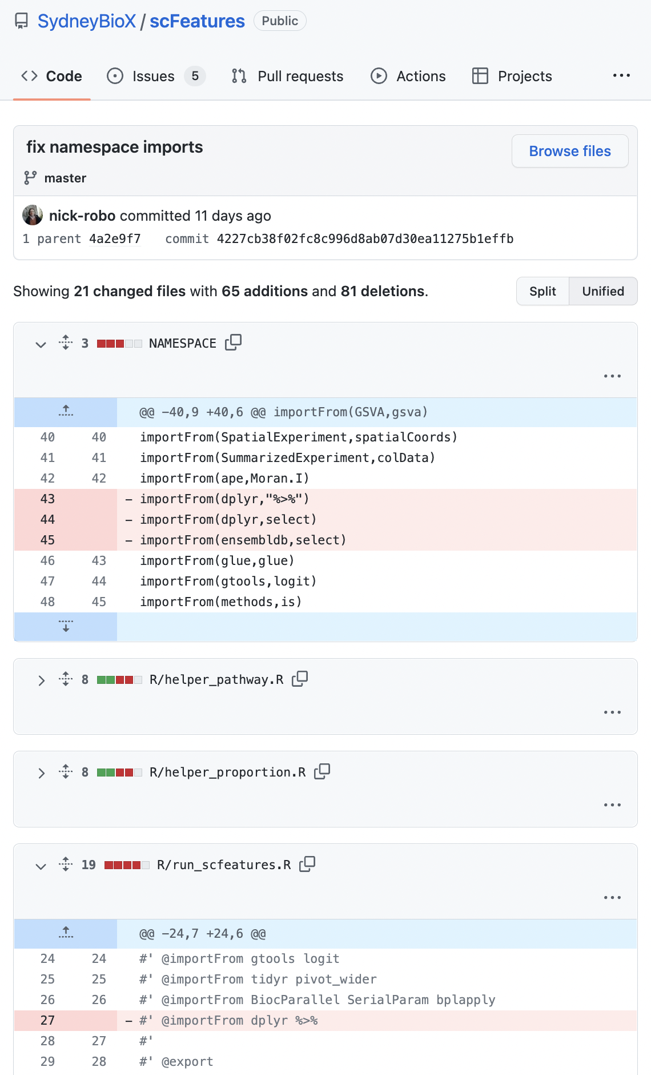
Fixing errors/warnings
Check the build reports.
Identify where the problem(s) occurred.
Optional: ask Bioconductor people!!
Attempt to fix your errors
Change your code locally
Check locally
Push to your own GitHub repo

Slide 45
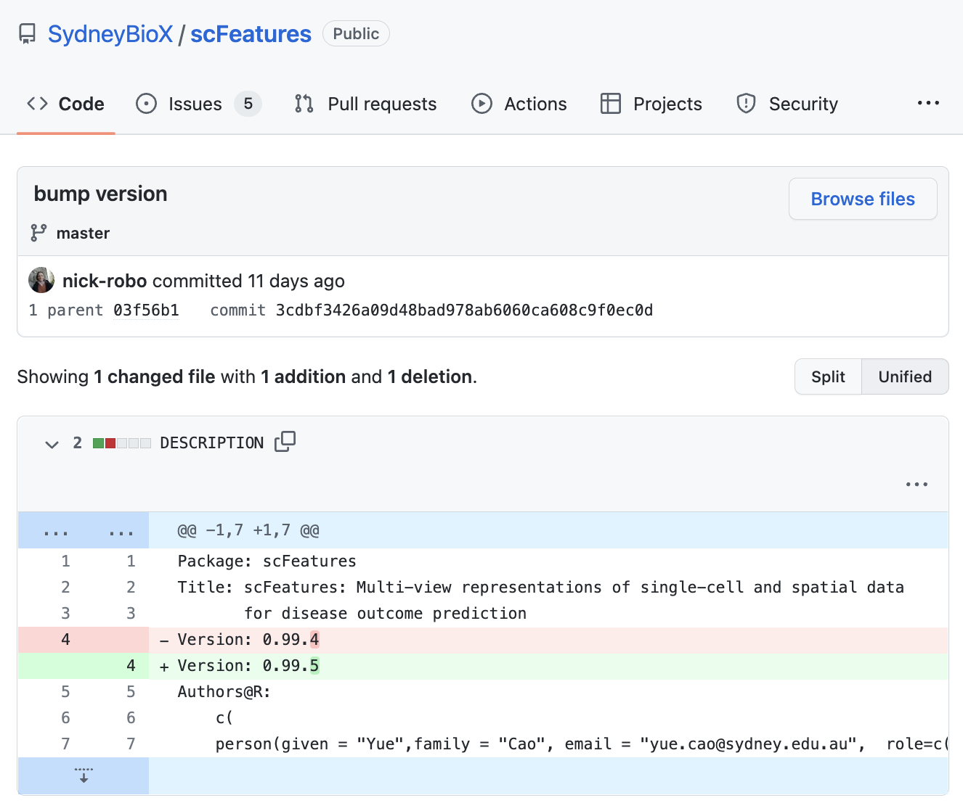
Fixing errors/warnings
Check the build reports.
Identify where the problem(s) occurred.
Optional: ask Bioconductor people!!
Attempt to fix your errors
Change your code locally
Check locally
Push to your own GitHub repo
Bump package version!

Slide 46
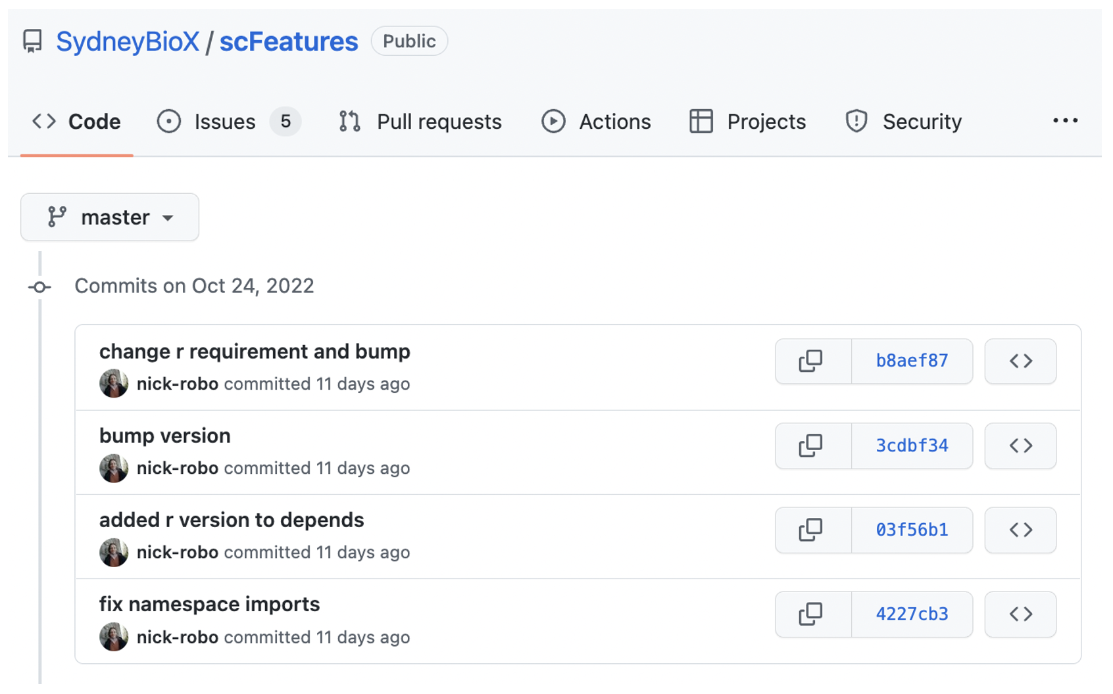
Fixing errors/warnings
Check the build reports.
Identify where the problem(s) occurred.
Optional: ask Bioconductor people!!
Attempt to fix your errors
Change your code locally
Check locally
Push to your own GitHub repo
Bump package version!
Forward in time

Slide 47
Fixing errors/warnings
Check the build reports.
Identify where the problem(s) occurred.
Optional: ask Bioconductor people!!
Attempt to fix your errors
Change your code locally
Check locally
Push to your own GitHub repo
Bump package version!
Push to Bioc upstream branch!!!!
## Add Bioconductor upstream remote
> git remote add upstream git@git.bioconductor.org:packages/<YOUR-REPOSITORY-NAME>.git
## Commit changes
> git add <files changed>
> git commit -m "<informative commit message>"
## Bump package version
> git add DESCRIPTION
> git commit -m ”bump to 0.99.4"
## Push to BioC upstream remote and your own remote
> git push
> git push upstream master

Slide 48
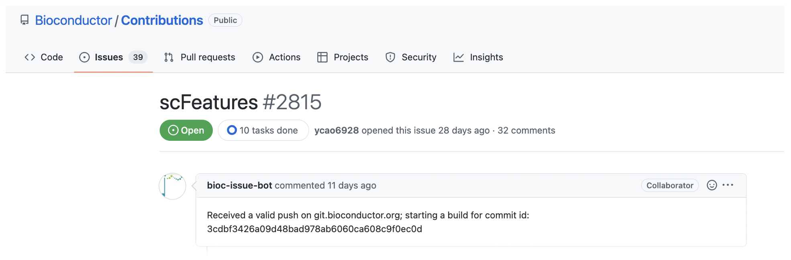
Fixing errors/warnings
Check the build reports.
Identify where the problem(s) occurred.
Optional: ask Bioconductor people!!
Attempt to fix your errors
Version bumping will trigger a new Single Package Builder run

Slide 49
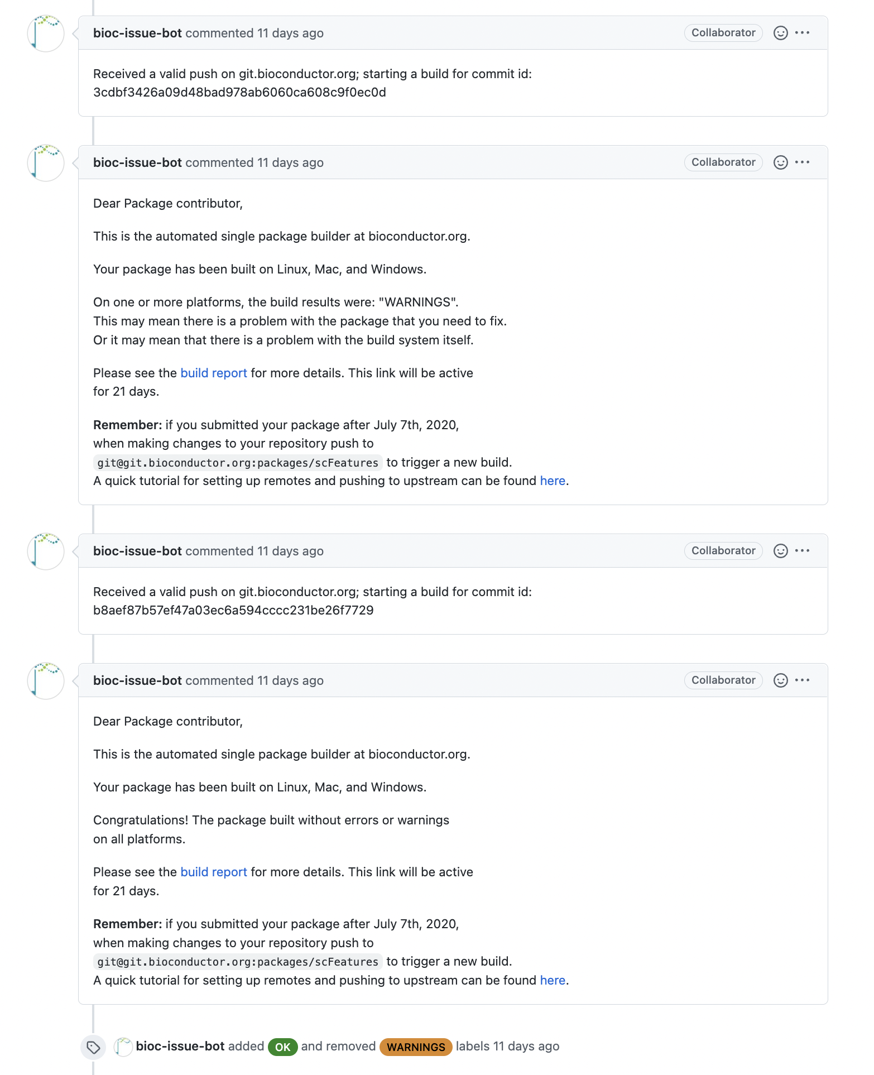
Fixing errors/warnings
Check the build reports.
Identify where the problem(s) occurred.
Optional: ask Bioconductor people!!
Attempt to fix your errors
Version bumping will trigger a new Single Package Builder run

Slide 50
Fixing errors/warnings
Check the build reports.
Identify where the problem(s) occurred.
Optional: ask Bioconductor people!!
Attempt to fix your errors
Version bumping will trigger a new Single Package Builder run

Slide 51
Fixing errors/warnings
Check the build reports.
Identify where the problem(s) occurred.
Optional: ask Bioconductor people!!
Attempt to fix your errors
Version bumping will trigger a new Single Package Builder run
Repeat…

Slide 52
Fixing errors/warnings
Check the build reports.
Identify where the problem(s) occurred.
Optional: ask Bioconductor people!!
Attempt to fix your errors
Version bumping will trigger a new Single Package Builder run
Repeat…

Slide 53
Fixing errors/warnings
Check the build reports.
Identify where the problem(s) occurred.
Optional: ask Bioconductor people!!
Attempt to fix your errors
Version bumping will trigger a new Single Package Builder run
Repeat…
Hurray 🎉🥳🎊

Slide 54
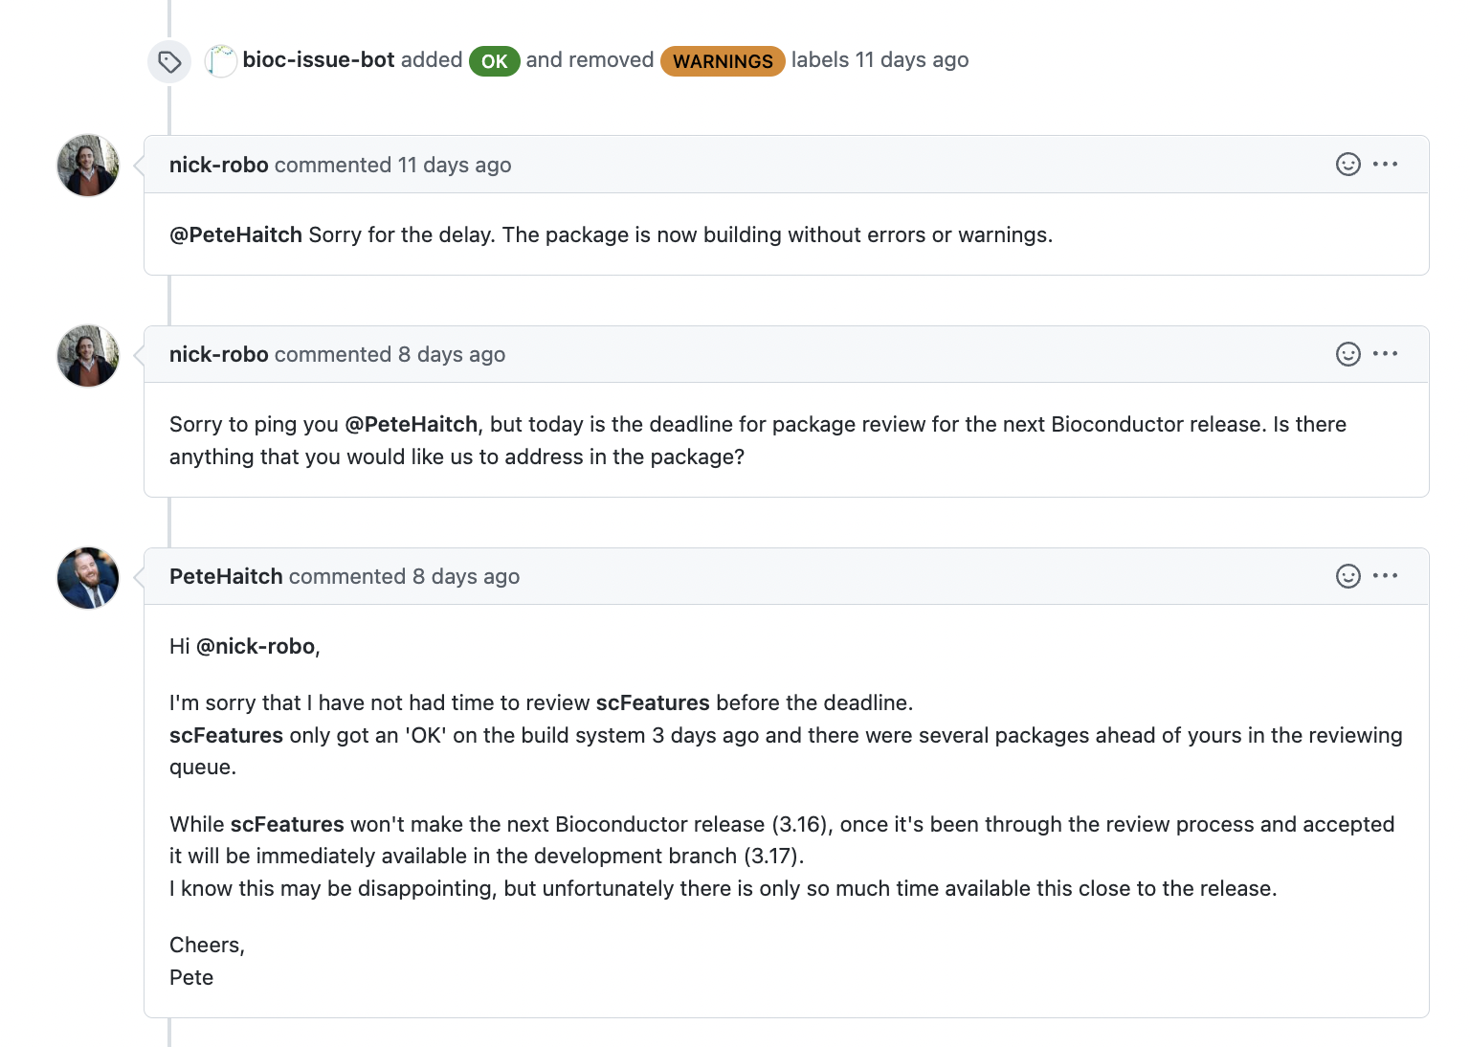
Fixing errors/warnings
Check the build reports.
Identify where the problem(s) occurred.
Optional: ask Bioconductor people!!
Attempt to fix your errors
Version bumping will trigger a new Single Package Builder run
Repeat…
Hurray 🎉🥳🎊
Well not so fast...

Slide 55
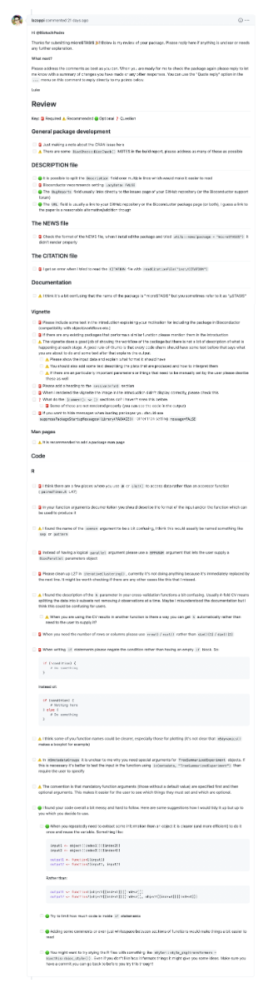
Reviewer’s comments
6. Addressing reviewer’s comments

Slide 56
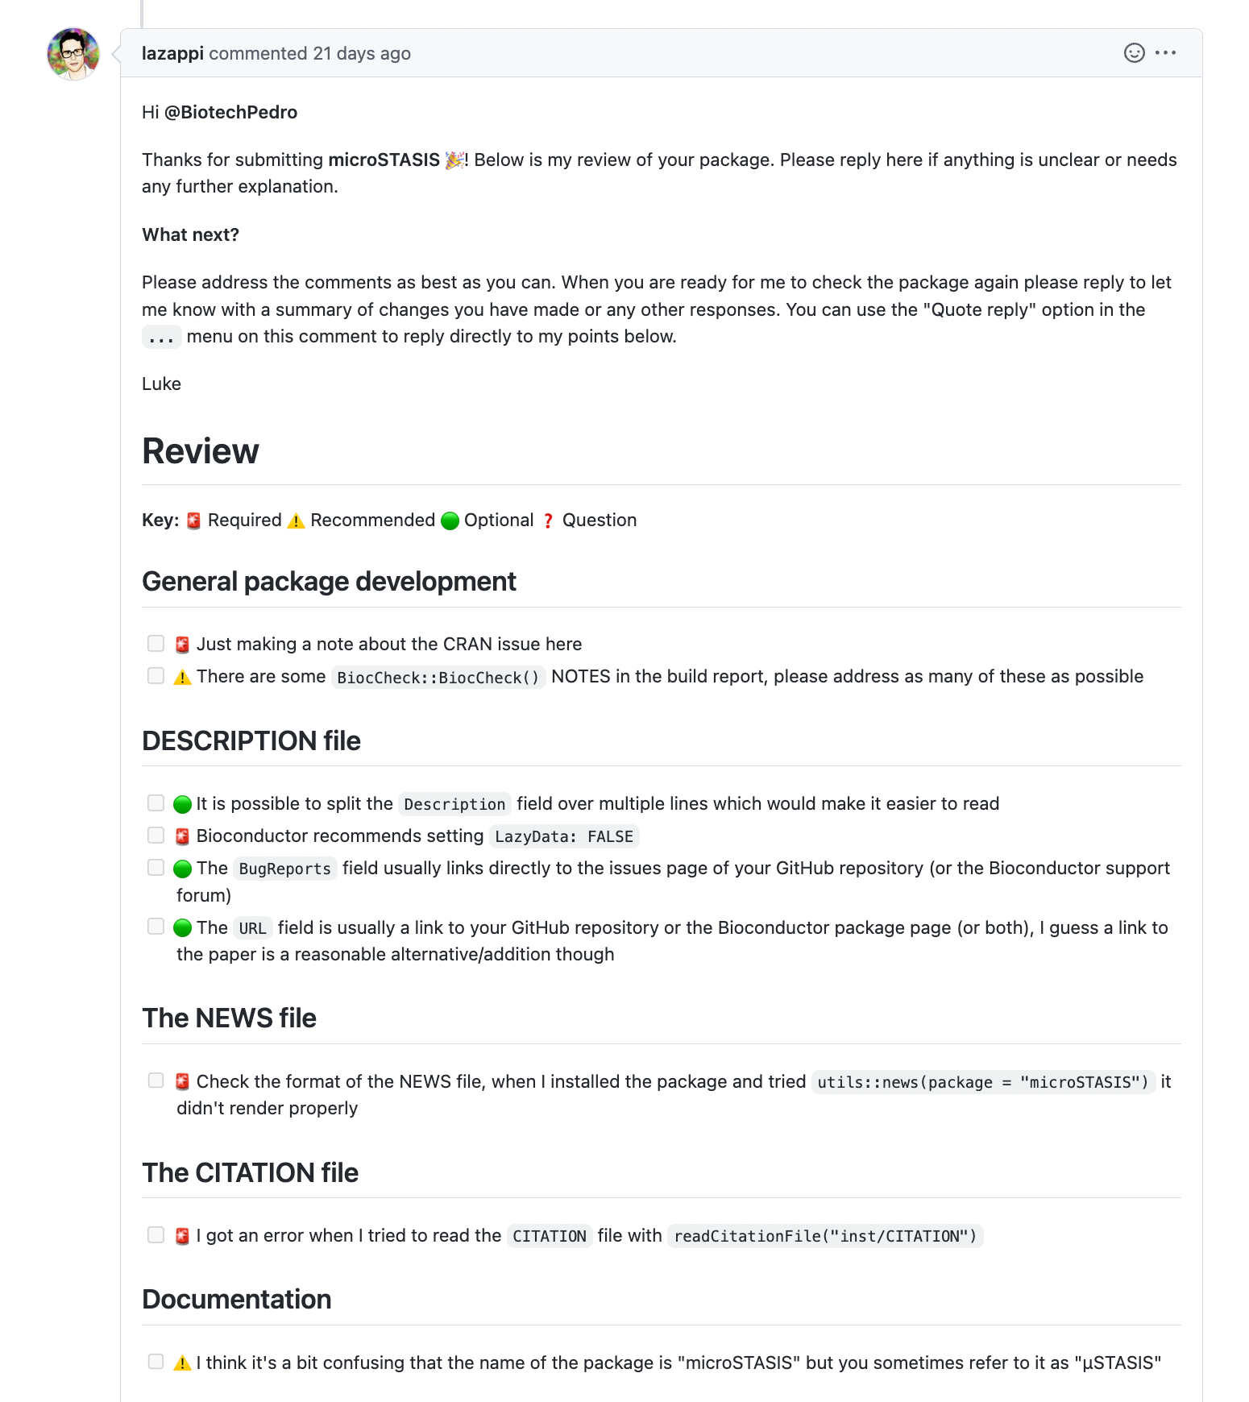
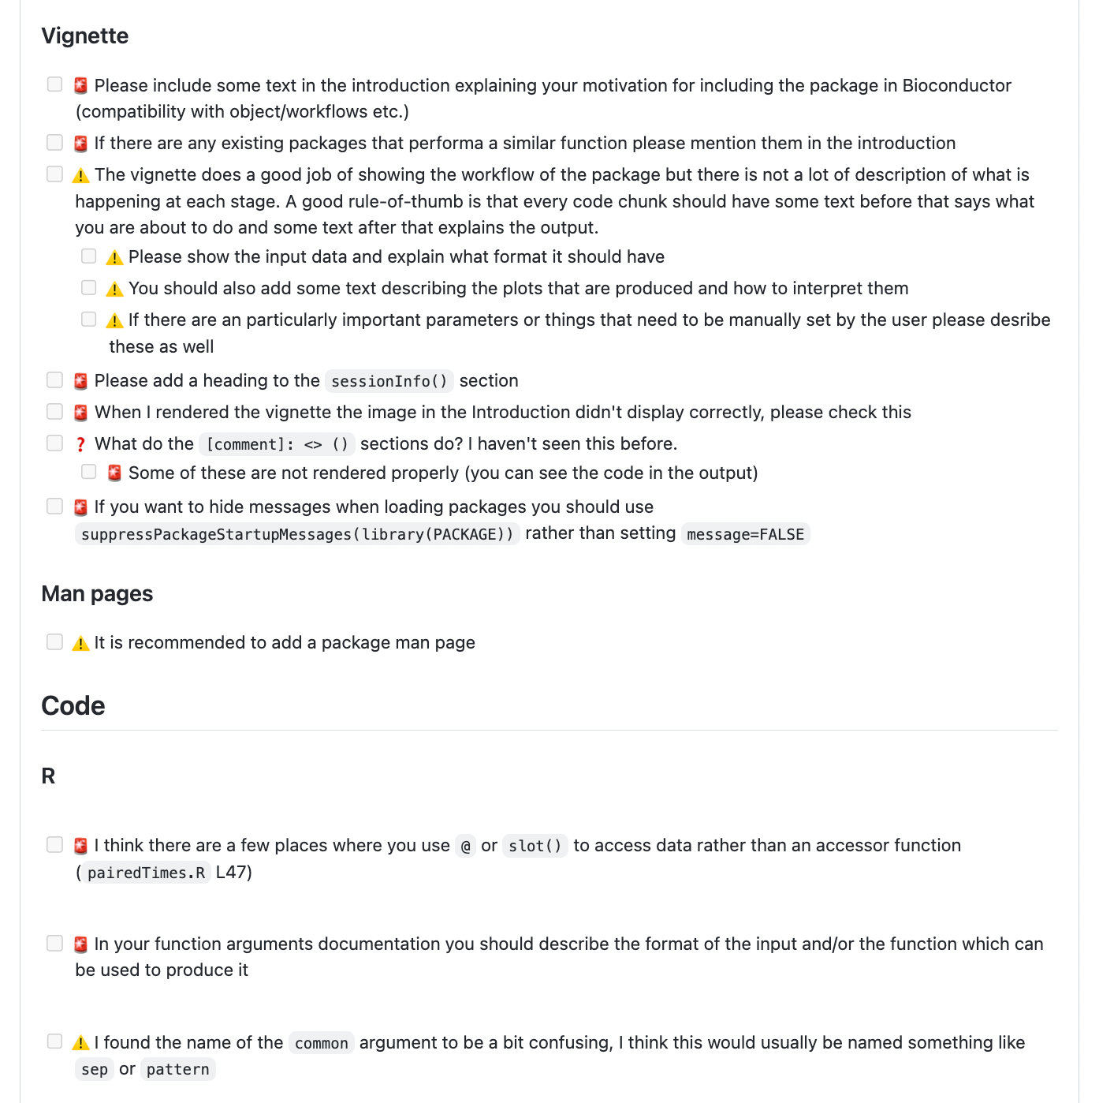
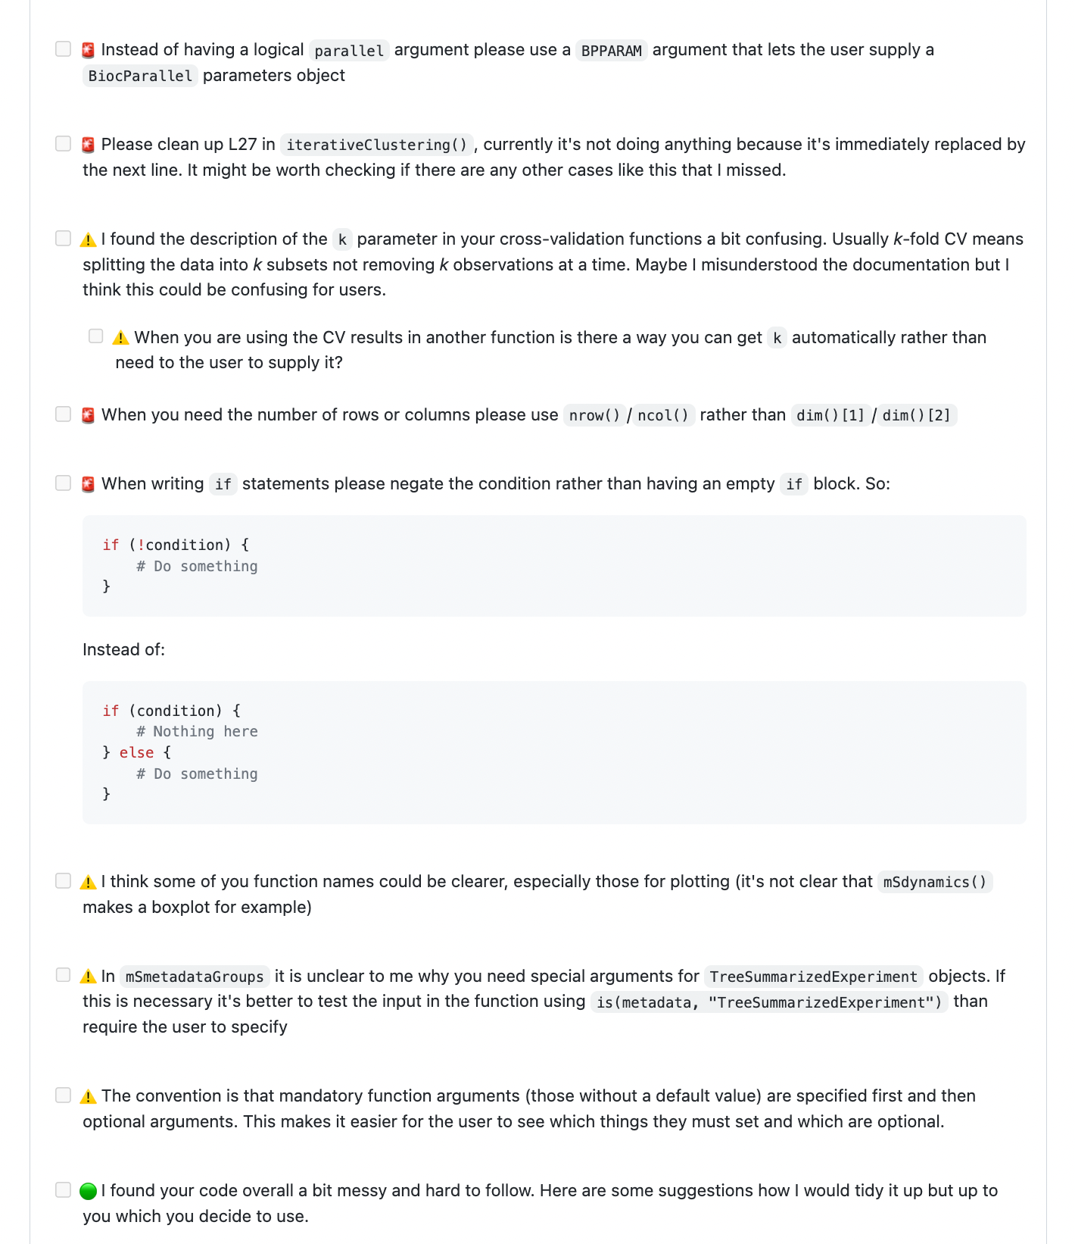
Reviewer’s comments
6. Addressing reviewer’s comments

Slide 57
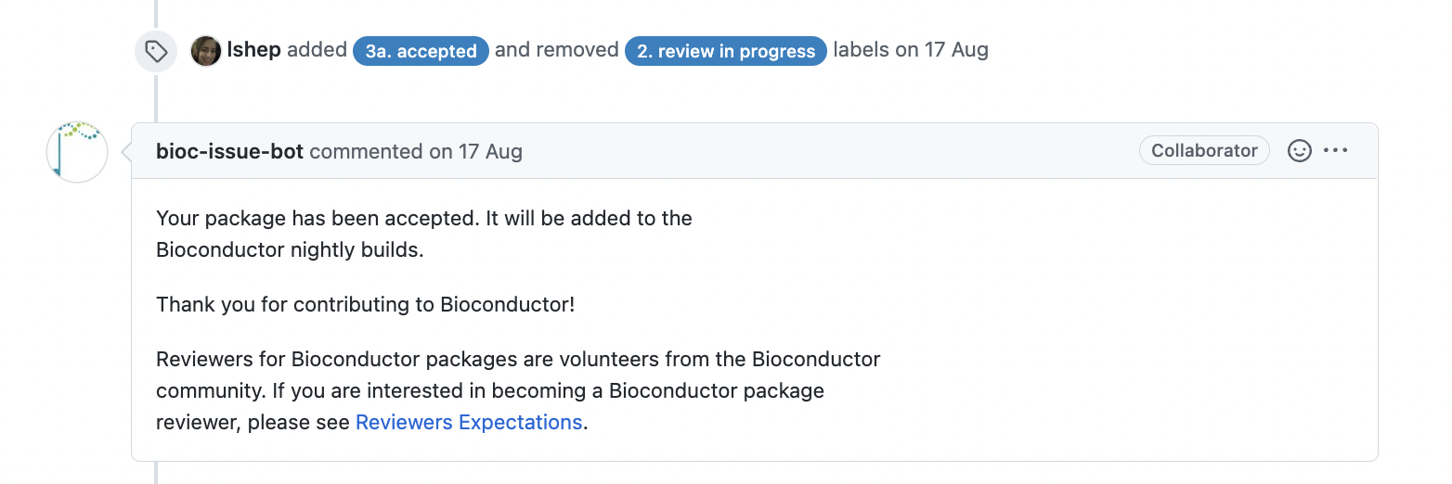
Reviewer’s comments
6. Addressing reviewer’s comments

Slide 58
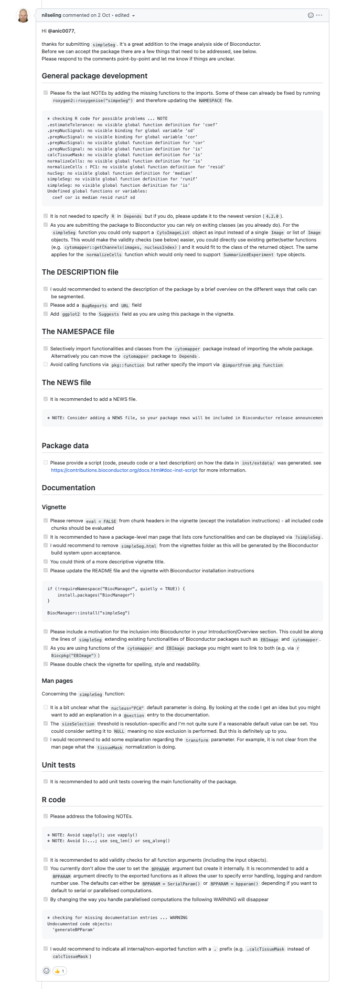
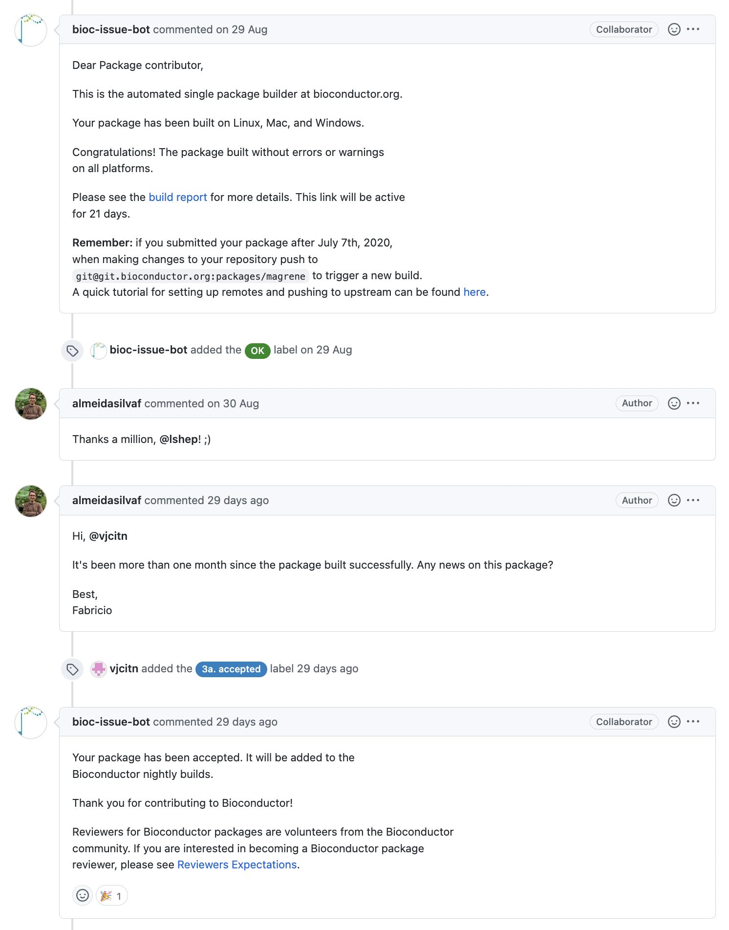
Reviewer’s comments
As a general principle, reviews are largely unfair/unhomogenized across reviewers. Sounds familiar?

Slide 59
Reviewer’s comments
As a general principle, reviews are largely unfair/unhomogenized across reviewers. Sounds familiar?

Slide 60
Maintaining package
Once your package is accepted, you will have to maintain it, e.g. to fix bugs/implement new functionalities.
Full instructions: https://contributions.bioconductor.org/git-version-control.html

Slide 61
Maintaining package
Maintaining a Bioconductor package will require to:
Pull upstream changes (There will be some!!! Don’t mess that up!)
## Check remotes
> git remote -v
origin git@github.com:<YOUR-GH-ID>/<YOUR-REPOSITORY-NAME>.git (fetch)
origin git@github.com:<YOUR-GH-ID>/<YOUR-REPOSITORY-NAME>.git (push)
upstream git@git.bioconductor.org:packages/<YOUR-REPOSITORY-NAME> (fetch)
upstream git@git.bioconductor.org:packages/<YOUR-REPOSITORY-NAME> (push)
## Pull upstream changes and sync remote origin
> git checkout master
> git fetch upstream
> git merge upstream/master
# ... Resolve merge conflicts if necessary... For more details, read https://contributions.bioconductor.org/git-version-control.html#resolve-merge-conflicts
> git push origin master

Slide 62
Maintaining package
Maintaining a Bioconductor package will require to:
Pull upstream changes (There will be some!!! Don’t mess that up!)
Commit changes to local master and push to remote origin & upstream (i.e. your GH and Bioconductor)
## Commit changes
> git checkout master
> git add <name of file changed>
> git commit -m "My informative commit message describing the change"
## Bump package version
> git add DESCRIPTION
> git commit -m ”bump to 1.0.1"
## Push your local commits to the remote origin (your GitHub)
> git push origin master
## Push your local commits to the remote upstream (Bioconductor)
> git push upstream master

Slide 63
Maintaining package
Maintaining a Bioconductor package will require to:
Pull upstream changes (There will be some!!! Don’t mess that up!)
Commit changes to local master and push to remote origin & upstream (i.e. your GH and Bioconductor)
If you intend to work a new functionalities, it’s recommended to do it in a separate local branch.
## Create new local branch and work there
> git checkout -b <NEW-FUNC-BRANCH>
# ...multiple rounds of edit, add, commit
## Merge with local master branch
> git checkout master > git merge <NEW-FUNC-BRANCH>
## Bump package version
> git add DESCRIPTION
> git commit -m ”bump to 1.0.1"
## Push your local commits to the remote origin (your GitHub)
> git push origin master
## Push your local commits to the remote upstream (Bioconductor)
> git push upstream master

Slide 64
Updating your origin after each Bioconductor release
At each Bioconductor release, a Bioconductor core member will:
Create a new branch for your package, in upstream remote (RELEASE_<#>)
## Locally clone your repository from Bioconductor (the “upstream” remote)
> git clone git@git.bioconductor.org:packages/<YOUR-REPOSITORY-NAME> && cd < YOUR-REPOSITORY-NAME>
Cloning into <YOUR-REPOSITORY-NAME>'...
## Check commits
> gitlog
* ad3c78e - (HEAD -> master, origin/master, origin/HEAD, origin/RELEASE_3_16) bump x.y.z version to even y prior to creation of RELEASE_3_16 branch (3 days ago) <J Wokaty>
* 6ccb53e - bump 0.99.11 (3 weeks ago) <js2264>
* ... previous commits ...

Slide 65
Updating your origin after each Bioconductor release
At each Bioconductor release, a Bioconductor core member will:
Create a new branch for your package, in upstream remote (RELEASE_<#>)
Update your package version (DESCRIPTION file) in this branch
## Check last commit
> git show
commit ad3c78e02c0b0210508ab3499a78f51e1fbdfcf0 (origin/RELEASE_3_16)
Author: J Wokaty <jennifer.wokaty@sph.cuny.edu>
Date: Tue Nov 1 11:27:34 2022 -0400
bump x.y.z version to even y prior to creation of RELEASE_3_16 branch
diff --git a/DESCRIPTION b/DESCRIPTION
index a9710ef..bda26ca 100644
--- a/DESCRIPTION
+++ b/DESCRIPTION
@@ -1,6 +1,6 @@
-Version: 0.99.11
+Version: 1.0.0

Slide 66
Updating your origin after each Bioconductor release
You must keep your local (and origin) repos in sync!
## Fetch changes from all remote branches (BioC upstream and your origin)
> git fetch --all
## Make sure you are working in master
> git checkout master
## Merge changes from BioC upstream and your origin
> git merge upstream/master
> git merge origin/master
# ... Resolve merge conflicts if any...
## Push your local commits to the remote origin (your GitHub) and remote upstream (Bioconductor)
> git push upstream master
> git push origin master

Slide 67
Updating your origin after each Bioconductor release
Don’t forget to do that for the release branch as well.
## Fetch changes from all remote branches (BioC upstream and your origin)
> git fetch --all
## Make sure you are working in master
> git checkout RELEASE_<#>
## Merge changes from BioC upstream and your origin
> git merge upstream/RELEASE_<#>
> git merge origin/RELEASE_<#>
# ... Resolve merge conflicts if any...
## Push your local commits to the remote origin (your GitHub) and remote upstream (Bioconductor)
> git push upstream RELEASE_<#>
> git push origin RELEASE_<#>

